Slide 1

USWDS Monthly Call
November 2022

Slide 2

Hi!
Thanks for being here!

Slide 3
Agenda
Product updates
User Profile Patterns, Part 2
Q&A

Slide 4
Product updates

Slide 5
USWDS 3.3.0
Inclusive patterns support

Slide 6
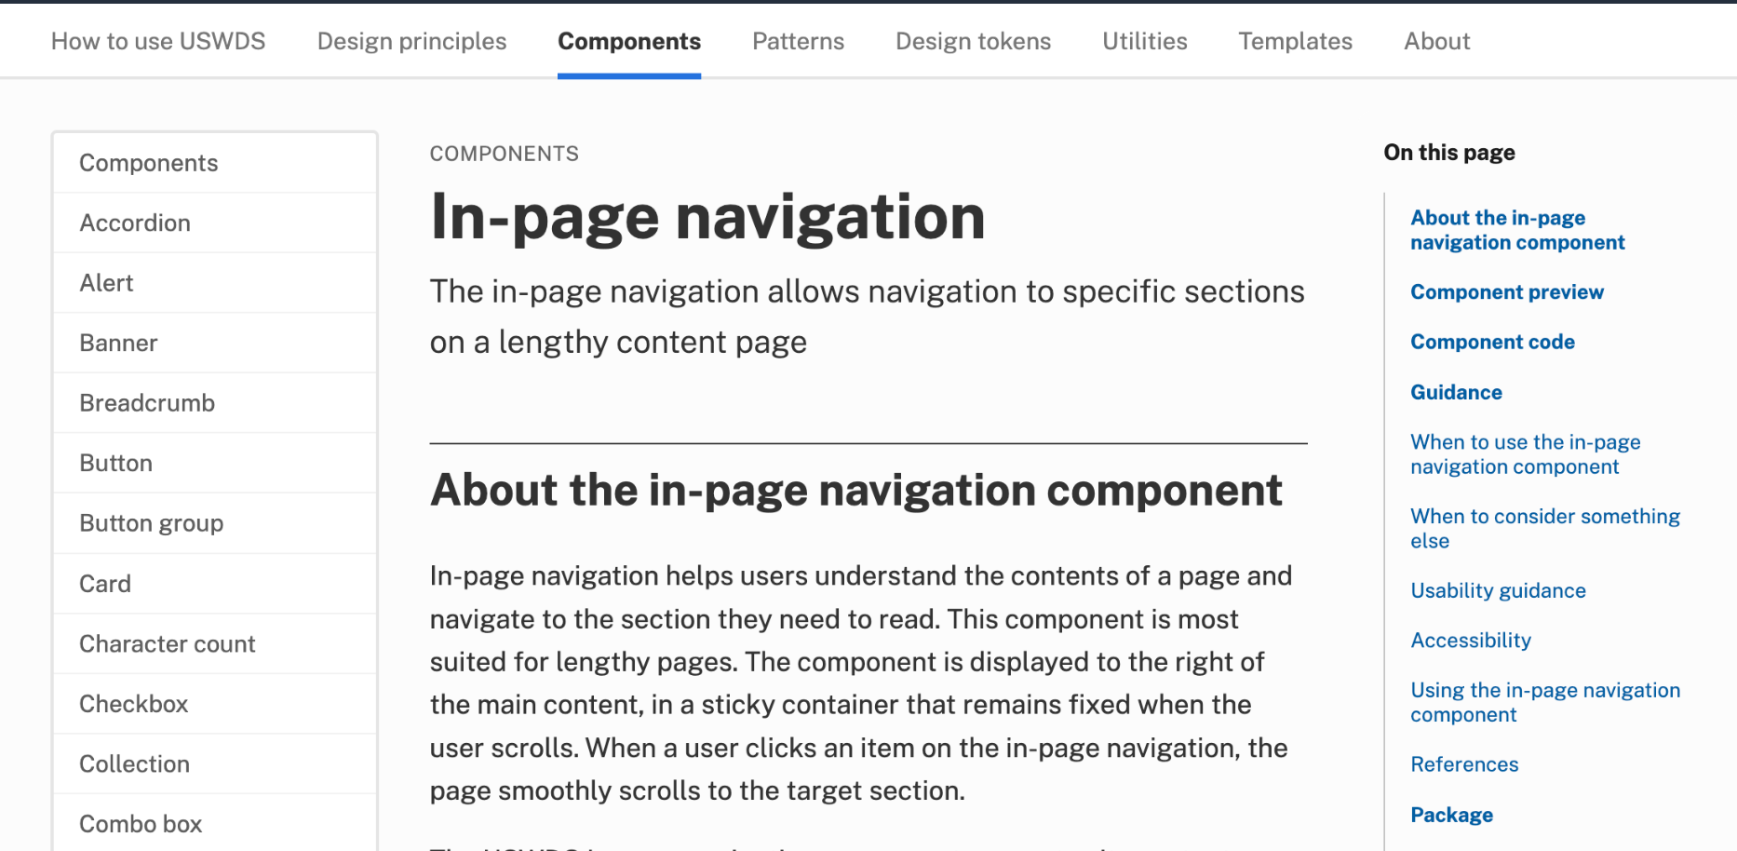
In-page navigation
designsystem.digital.gov/components/in-page-navigation

Slide 7
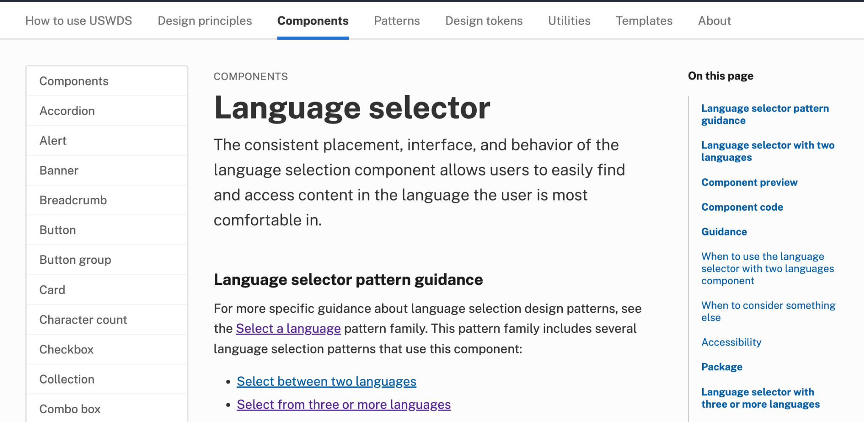
Language selector
designsystem.digital.gov/components/language-selector

Slide 8
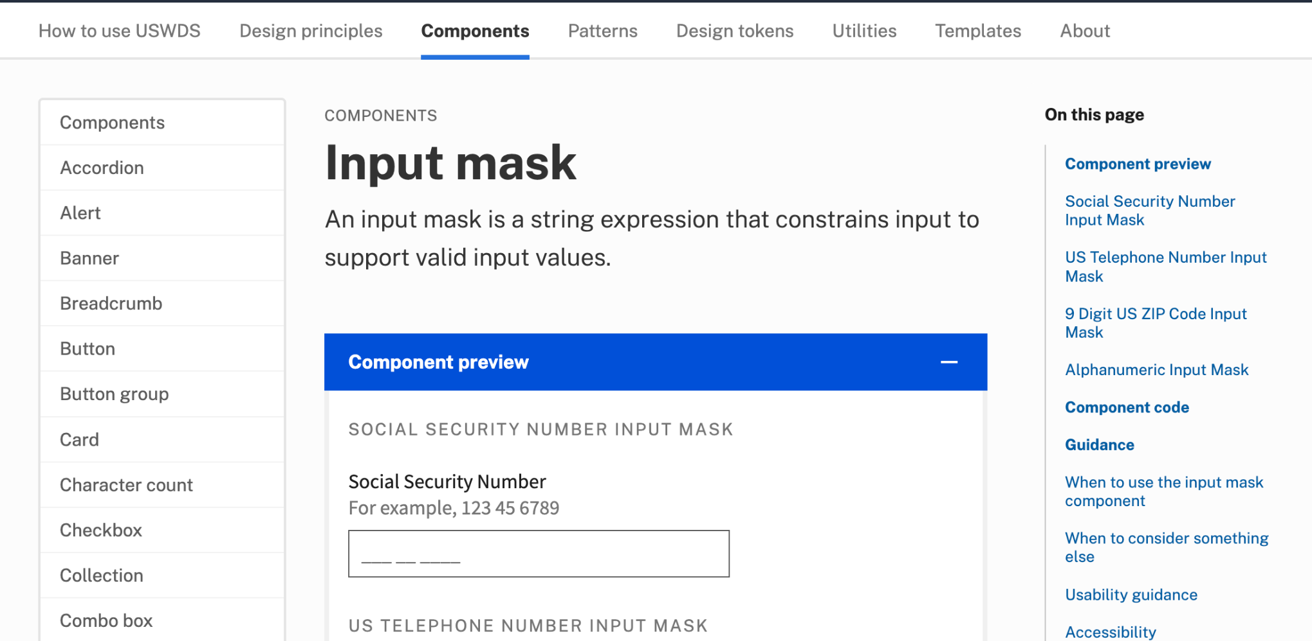
Input mask
designsystem.digital.gov/components/input-mask

Slide 9
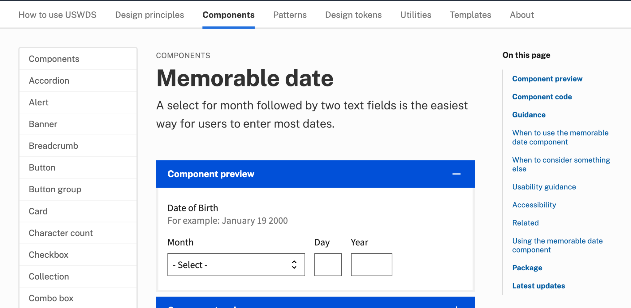
Update: Memorable date
designsystem.digital.gov/components/memorable-date

Slide 10
USWDS 3.3.0
Out now

Slide 11
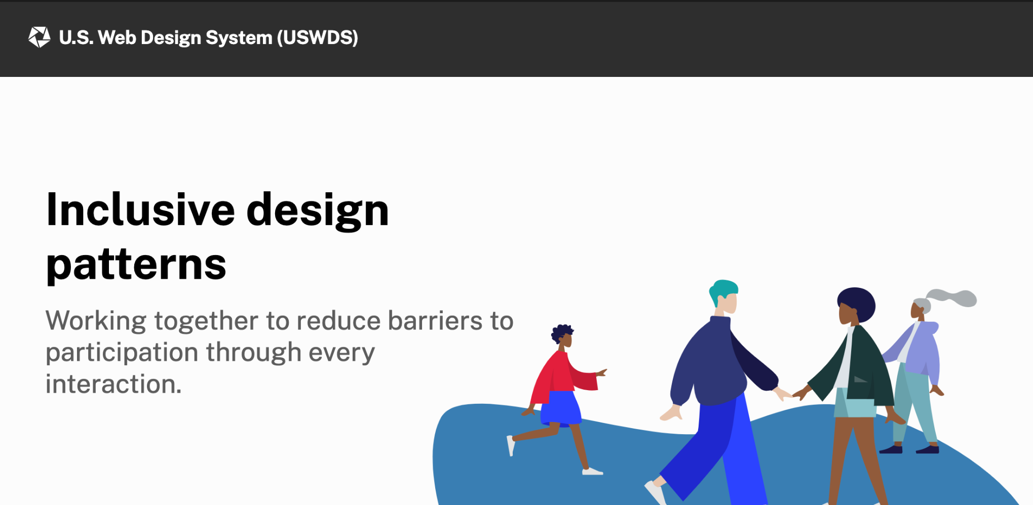
Together: An inclusive design report
designsystem.digital.gov/together

Slide 12
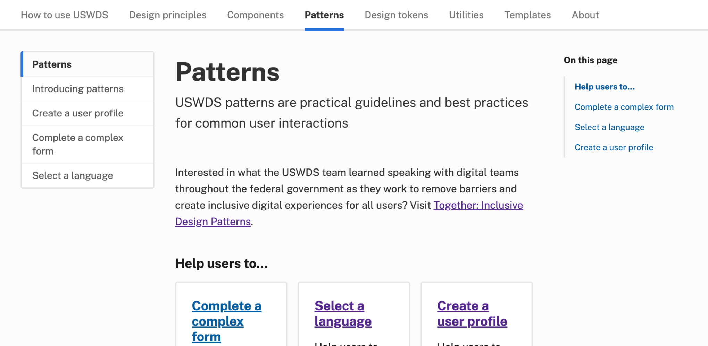
Pattern guidance
designsystem.digital.gov/patterns

Slide 13
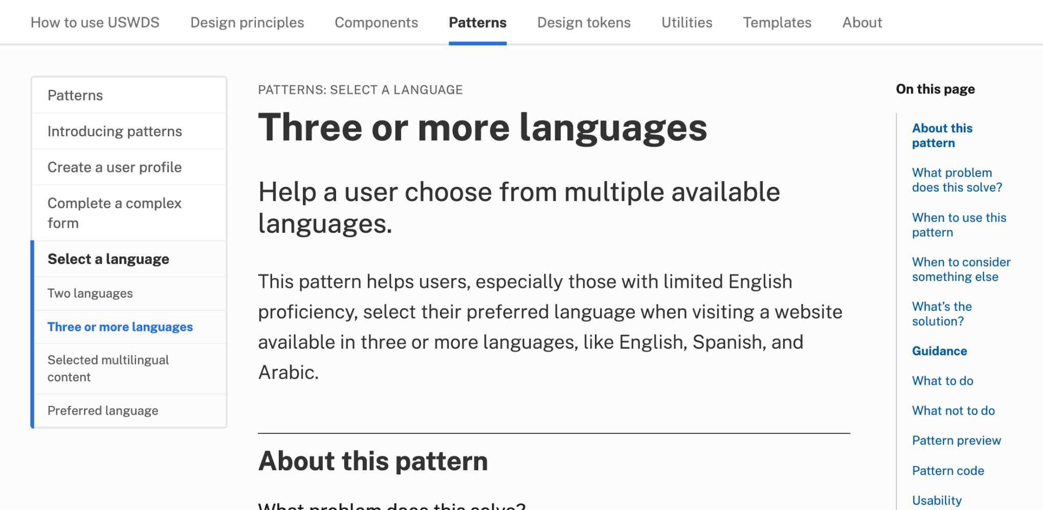
Pattern guidance: Language selection
designsystem.digital.gov/patterns/select-a-language/three-or-more-languages/

Slide 14
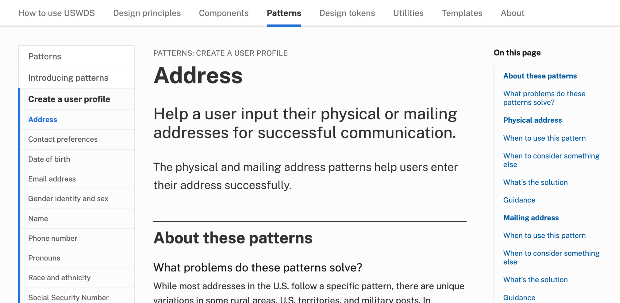
Pattern guidance: Address
designsystem.digital.gov/patterns/create-a-user-profile/address/

Slide 15
In-page navigation in action

Slide 16
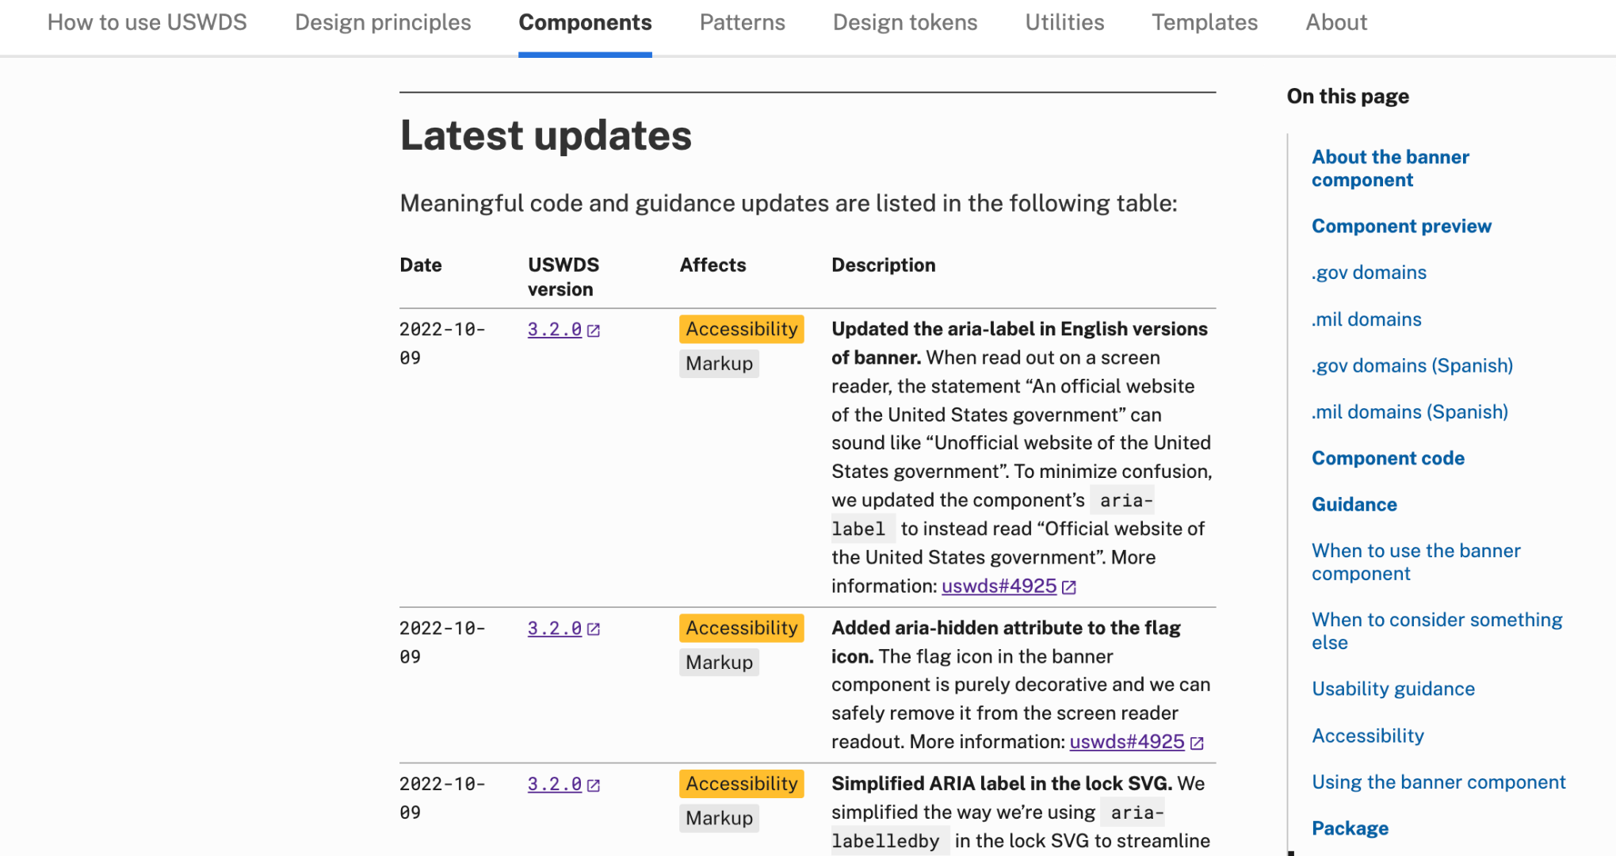
Latest updates
Changelogs for components, patterns, and guidance

Slide 17
Demo

Slide 18
The runway and the plane

Slide 19
Together

Slide 20
User Profile Patterns, Part 2 Personal information patterns

Slide 21
Meghan O’Meara
she/her
Content Strategist Inclusive Patterns
Contractor

Slide 22
Jona Decker
she/her
Technologist Inclusive Patterns
Contractor

Slide 23
Austin Hernandez
he/they
Sr. Product Designer 18F

Slide 24
Help a user to _________.

Slide 25
Reduce barriers to participation through every interaction

Slide 26
Relevant, clean data.
Good form design.
Inclusive experiences.

Slide 27
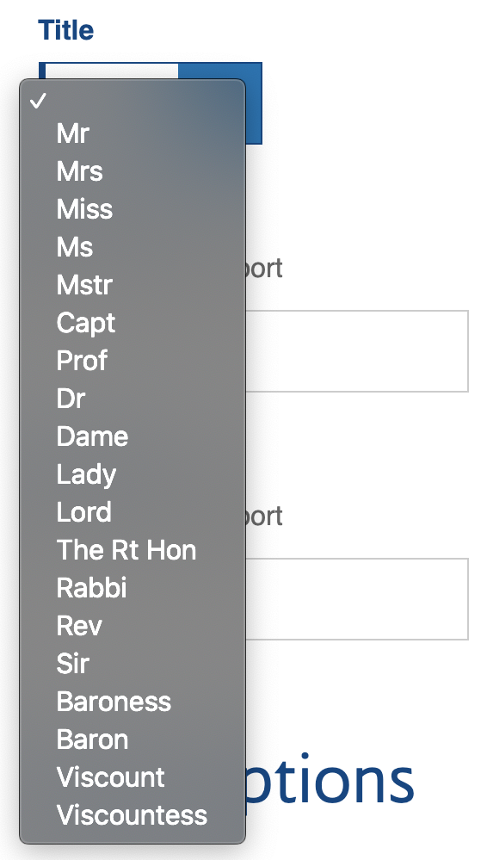
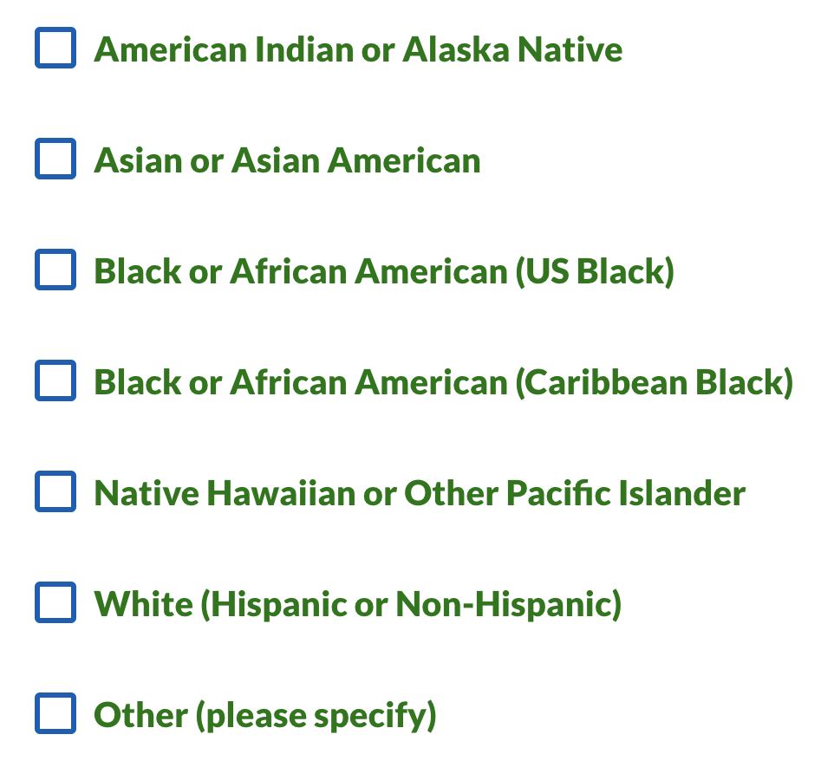
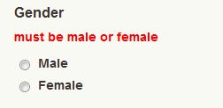
Three examples of exclusionary form design

Slide 28
Race and ethnicity

Slide 29
Race and ethnicity are often central to an individual’s sense of self

Slide 30
A social definition of race

Slide 31
Race: If you don’t need to know, don’t ask.

Slide 32
But sometimes you do need to know.

Slide 33
Racial categories provided by OMB
American Indian or Alaska Native
Asian
Black or African American
Native Hawaiian or Other Pacific Islander
White

Slide 34
People identify as multiple races

Slide 35
Ethnicity categories provided by OMB
Hispanic or Latino
Not Hispanic or Latino

Slide 36
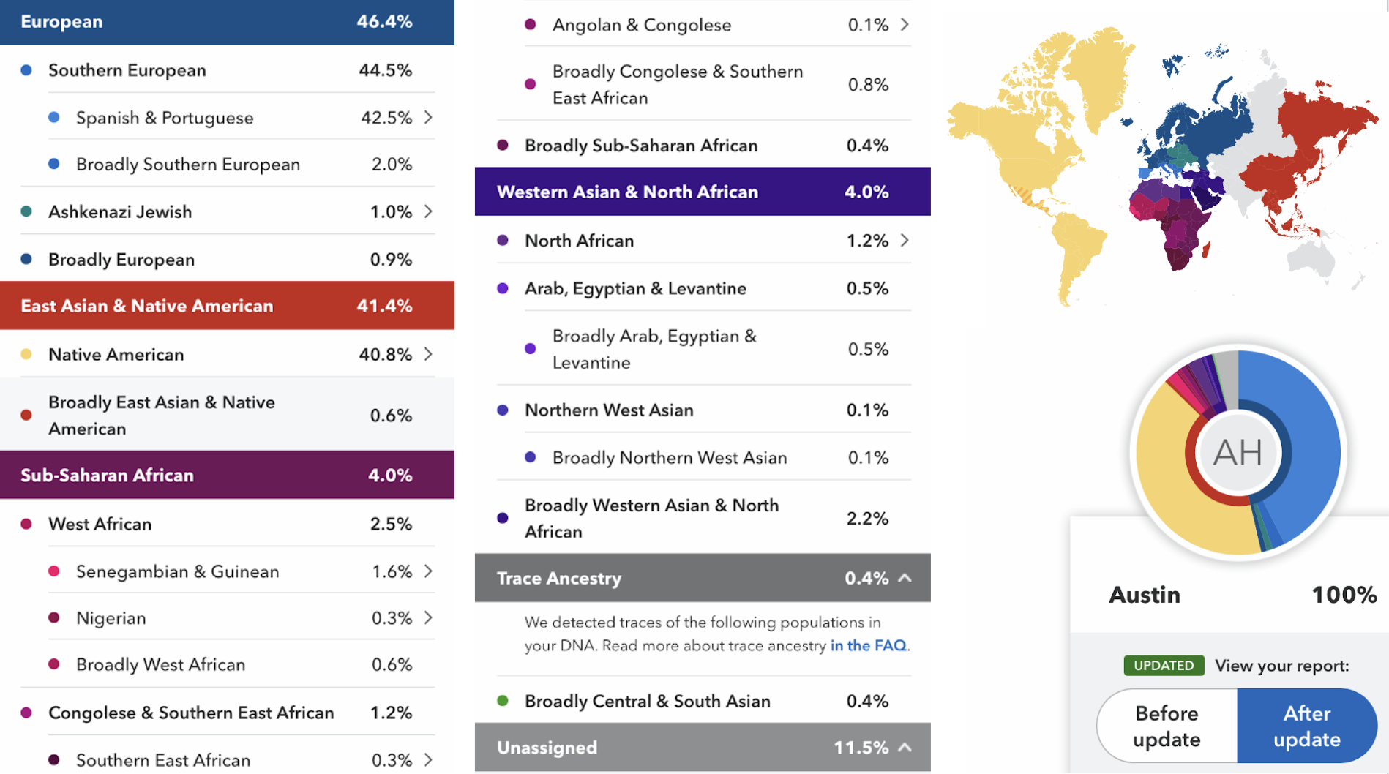
Genetic testing for ancestry results

Slide 37
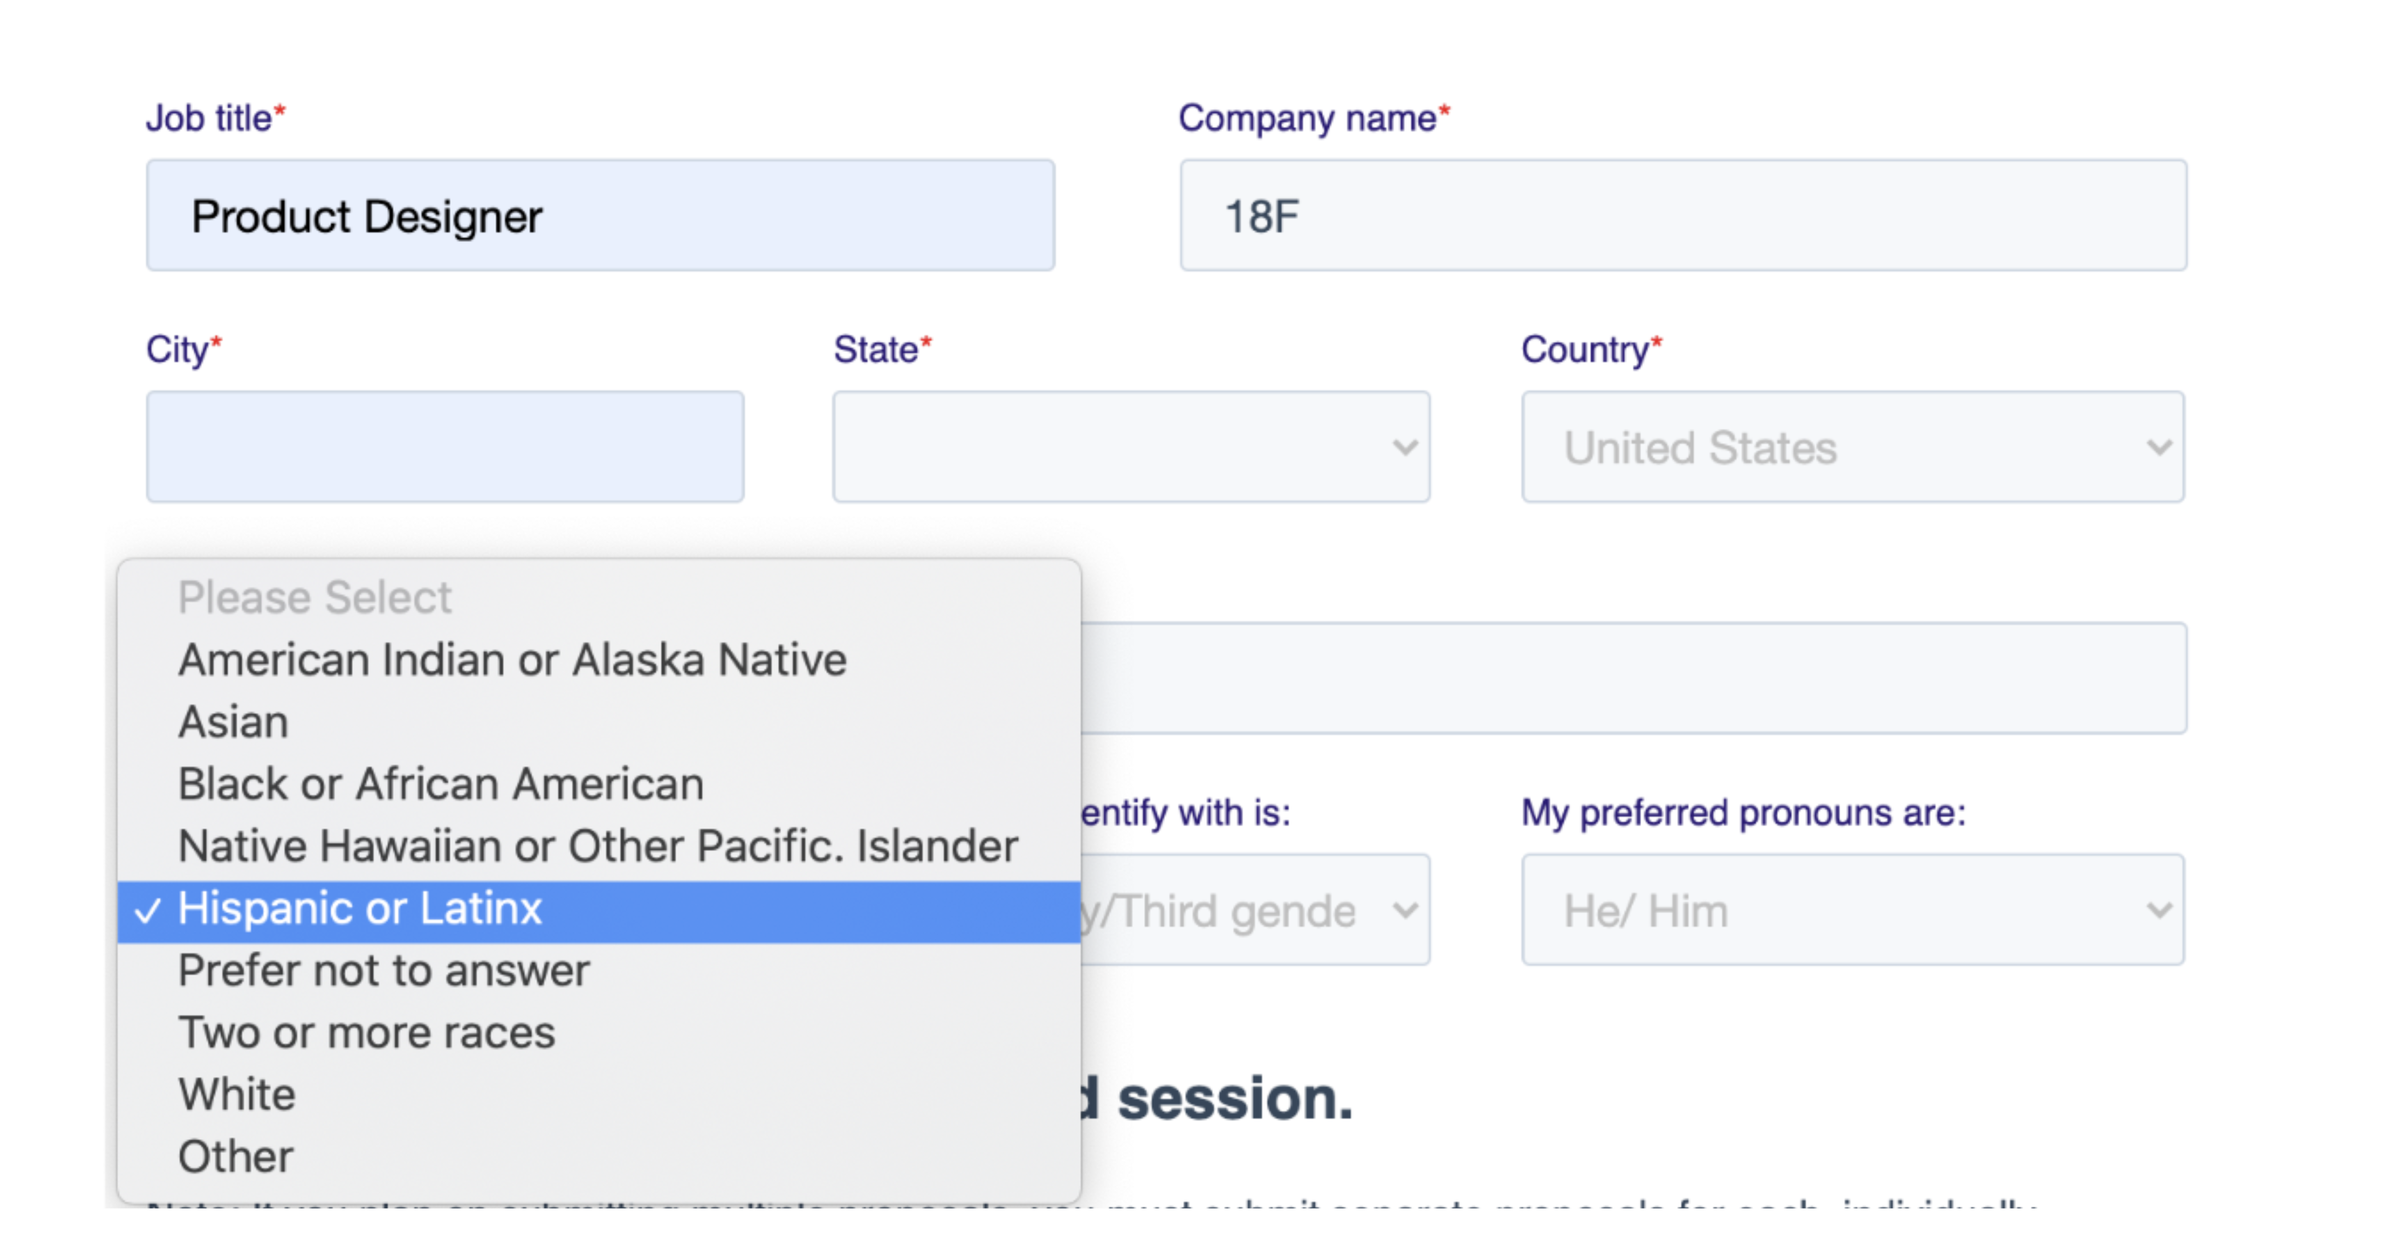
Choosing a single race and ethnicity from a dropdown

Slide 38
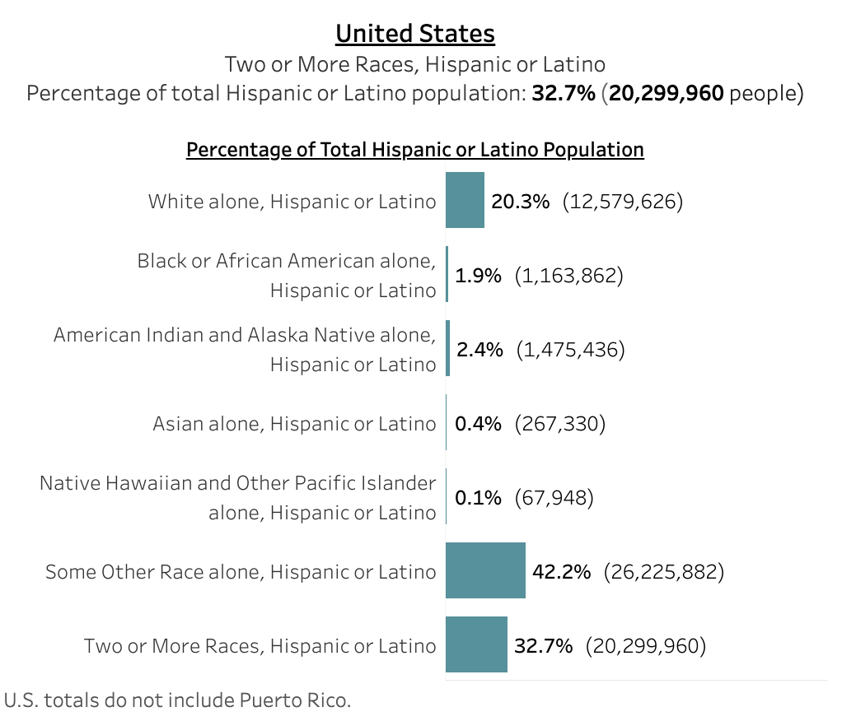
Census 2020 Hispanic and Latino race categorization

Slide 39
Race ≠ Ethnicity ≠ Nationality

Slide 40
Race is a social construct.
At best, it’s used to measure inequity and make positive change. At worst, it’s used for discrimination and harm.

Slide 41
Use meaningful categories for your program and allow self-identification

Slide 42
OMB requires that race and ethnicity data map to their categories…
Race
American Indian or Alaska Native
Asian
Black or African American
Native Hawaiian or Other Pacific Islander
White
Ethnicity
Hispanic or Latino
Not Hispanic or Latino

Slide 43
OMB encourages you to collect more detailed race and ethnicity information, as long as it ladders up to these categories
Race
American Indian or Alaska Native
Asian
Black or African American
Native Hawaiian or Other Pacific Islander
White
Ethnicity
Hispanic or Latino
Not Hispanic or Latino

Slide 44
Do not separate race from ethnicity. Ask about them together.

Slide 45
Allow users to choose more than one race and ethnicity.

Slide 46
If possible, allow users to self-identify their ethnicity.

Slide 47
Always explain why.

Slide 48
Gender identity and sex

Slide 49
Gender is a social construct. At best, it’s used to measure inequity and make positive change. At worst, it’s used for discrimination and harm.

Slide 50
Gender ≠ Sex ≠ Pronouns

Slide 51
Many terms that describe
gender identities
have evolved over time.

Slide 52
Be inclusive. Be respectful. Listen for changes in terms and conventions.

Slide 53
Important to people’s identities

Slide 54
There are safety issues with asking for this information.

Slide 55
This week is Transgender Awareness Week.
November 20 is Transgender Day of Rememberance.

Slide 56
Gender identity and sex: If you don’t need to know, don’t ask.

Slide 57
Sex: Male, Female, X

Slide 58
Research is ongoing

Slide 59
Ask about sex and gender identity separately

Slide 60
Sex

Slide 61
Sex:
Clearly state why you need this information

Slide 62
Sex:
Provide only biological options

Slide 63
Sex:
Clearly state if this information needs to match a specific document

Slide 64
Sex:
Don’t include “Prefer not to answer”

Slide 65
Gender identity

Slide 66
Gender and gender identity

Slide 67
Gender identity:
Allow people to specify their gender identity in their own words

Slide 68
Gender identity:
Do include “Prefer not to answer”

Slide 69
Asking for
gender identity and sex
together

Slide 70
Pronouns

Slide 71
Pronouns are not the same as gender identity

Slide 72
Respect pronoun preference

Slide 73
Pronouns:
Allow people to enter pronouns in their own words

Slide 74
Pronouns:
Provide examples

Slide 75
Pronouns:
Don’t make pronouns mandatory

Slide 76
Pronouns:
Be prepared for complex answers

Slide 77
We’re grateful to our colleagues

Slide 78
Input from many teams and sources

Slide 79






























You know your audience.

Slide 80
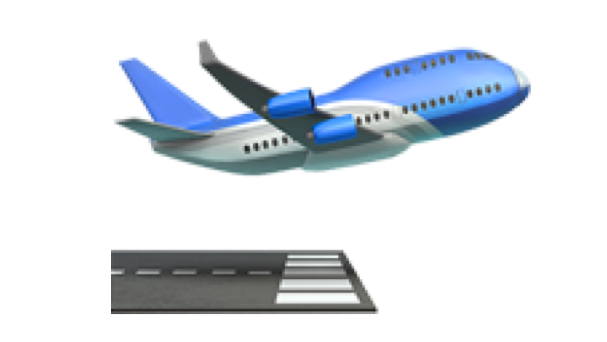
Onward!

Slide 81
Q&A

Slide 82
Next month
December: USWDS Year in Review
#uswds-public
github.com/uswds
designsystem.digital.gov

